Slide 1
Peer Perspective
Saurabh Singh

Slide 2

Education
Notes:
http://www.5minutesformom.com/wp-content/uploads/2013/11/student_doing_a_math_problem.jpg

Slide 3



Resources for Students:
Internet (Google, Khan, etc)
Instructors
Textbooks

Slide 4
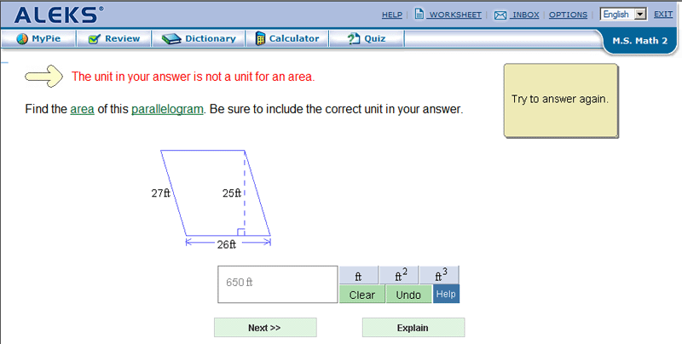
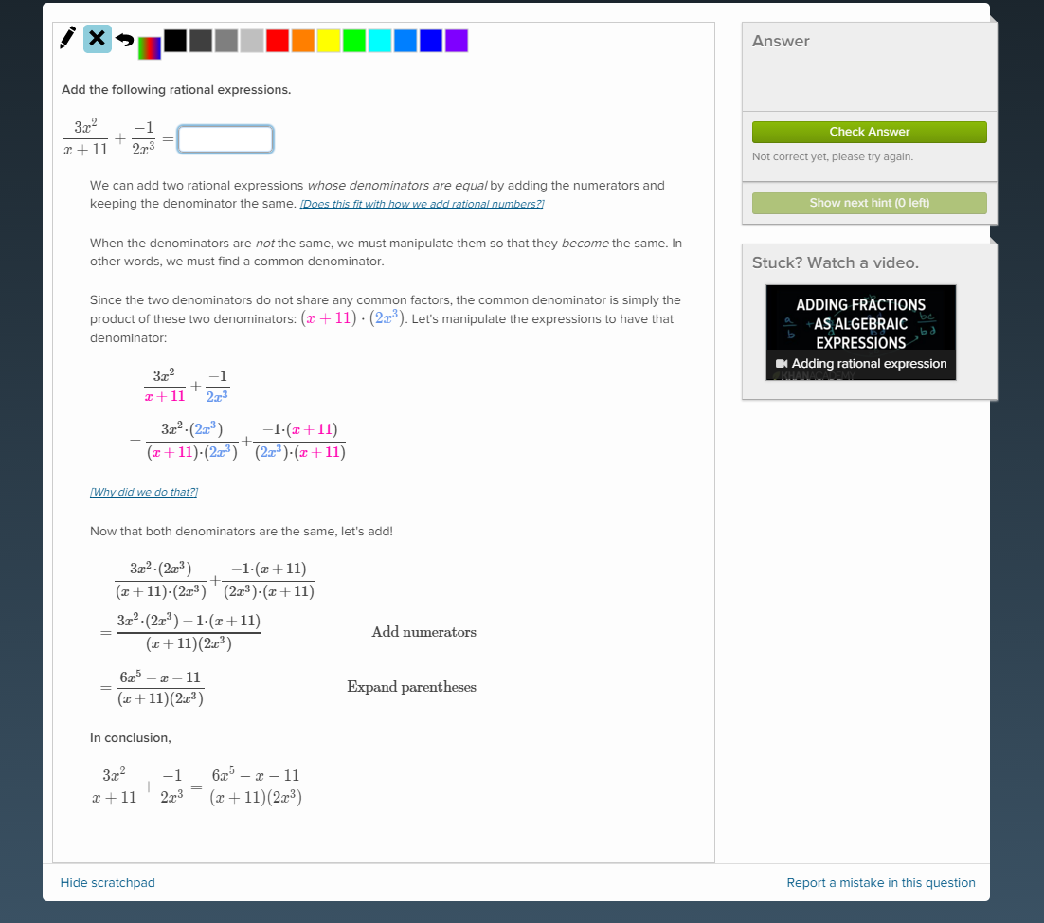
ALEKS
Khan Academy

Slide 5
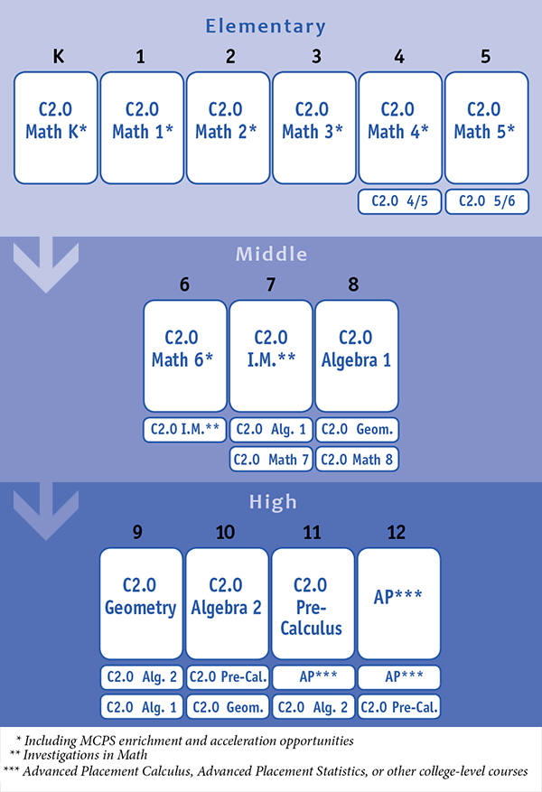

Slide 6
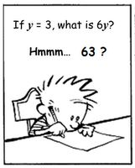
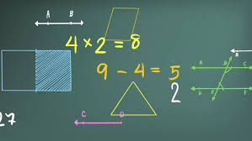
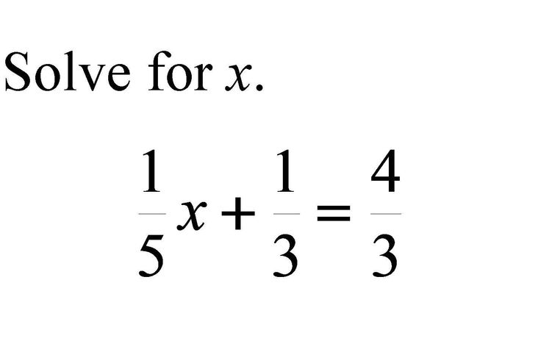
Peer Perspective
Topics
List of Misconceptions per topic
Problems

Slide 7




Problems
1
2
3
Misconception Randomly Selected
Randomly generated problem injected with a misconception
Progression system with increasing difficulty

Slide 8
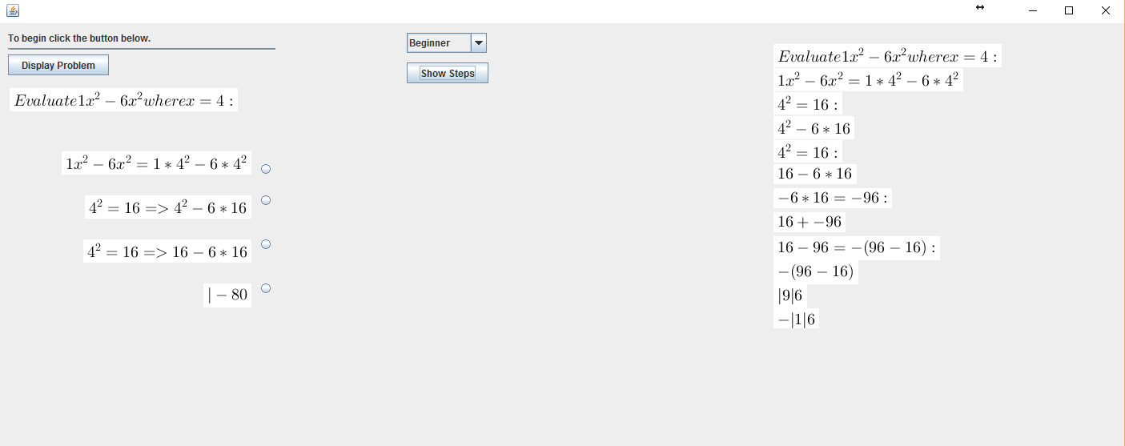

Slide 9
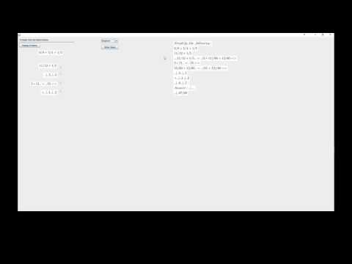
DEMO

Slide 10
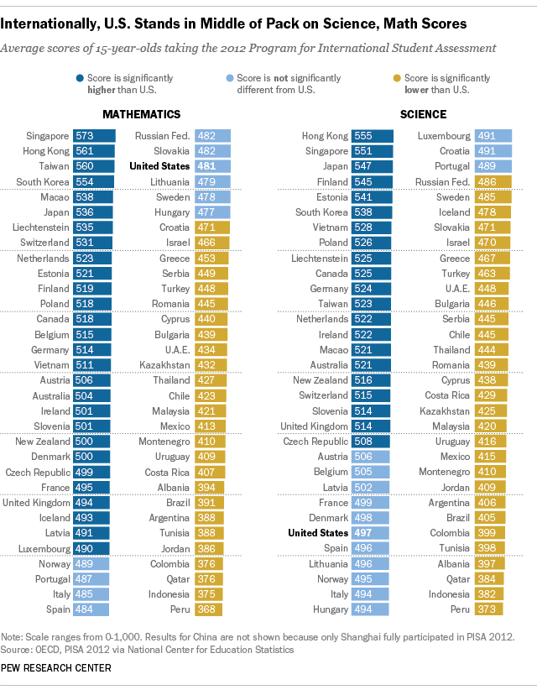
Education
Out of 64 countries the 15 year olds in the US are:
Ranked 35th in Math
Ranked 27th in Science.

Slide 11
CLOSING

